Slide 1
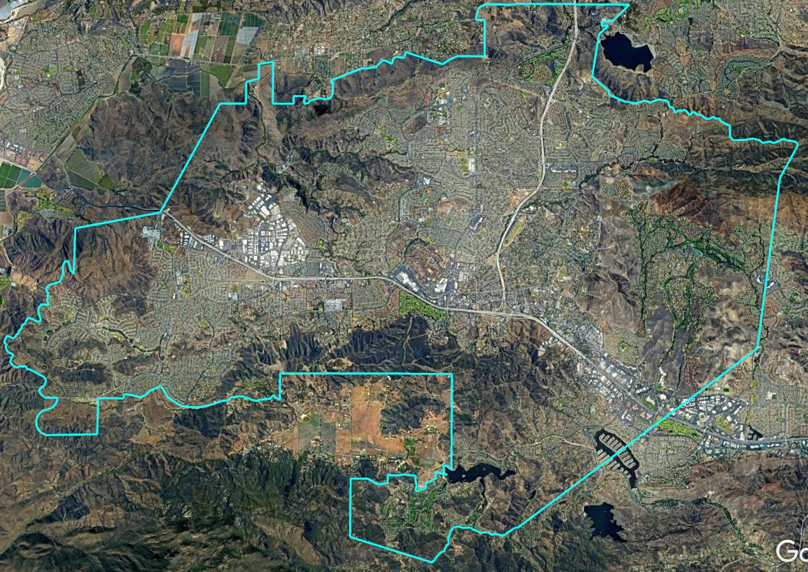
Conejo Recreation and Parks District Introduction to Districting
Dr. Douglas Johnson, Vice President
National Demographics Corporation

Slide 2
Election Systems
“At Large”
“From District” or “Residence” Districts
“By District”
The California Voting Rights Act was written to specifically encourage by-district elections.

Slide 3
California Voting Rights Act (CVRA)
Under the Federal Voting Rights Act (passed in 1965), a jurisdiction must fail 4 factual tests before it is in violation of the law.
The California VRA makes it significantly easier for plaintiffs to force jurisdictions into “by-district” election systems by eliminating one and arguably two of the US Supreme Court Gingles tests:
Can the protected class constitute the majority of a district?
Does the protected class vote as a bloc?
Do the voters who are not in the protected class vote in a bloc to defeat the preferred candidates of the protected class?
Do the “totality of circumstances” indicate race is a factor in elections?
Liability is now arguably determined only by the presence of racially polarized voting

Slide 4
CVRA Impact
Switched (or in the process of switching) as a result of CVRA:
At least 275 school districts
36 Community College Districts
174 cities
1 County Board of Supervisors
53 water and other special districts.
Cases So Far:
Palmdale, Santa Clara and Santa Monica went to trial on the merits. Palmdale and Santa Clara lost. Santa Monica is awaiting a decision.
Modesto and Palmdale each spent about $1.8 million on their defense (in addition to the attorney fee awards in those cases).
Santa Monica has spent an estimated $7 million so far. Plaintiffs in Santa Monica requested $22 million in legal fees after the original trial.
Key settlements:
Palmdale: $4.7 million
Modesto: $3 million
Highland: $1.3 million
Anaheim: $1.1 million
Whittier: $1 million
Santa Barbara: $600,000
Tulare Hospital: $500,000
Camarillo: $233,000
Compton Unified: $200,000
Madera Unified: about $170,000
Hanford Joint Union Schools: $118,000
Merced City: $42,000
An estimated $18 million in total settlements and court awards so far.

Slide 5
Districting Process
Step | Description
Two Initial Hearings Nov. 17 & Dec. 1 | Held prior to release of draft maps. Education and to solicit input on the composition of districts.
Release draft maps | Maps must be posted at least 7 days prior to 3rd hearing.
Two hearings on draft maps Dec. 15 & Jan. 5 | Two meetings to discuss and revise the draft maps and to discuss the election sequence.
Board Action Jan. 19 | Map should be posted at least 7 days prior to Board action.

Slide 6
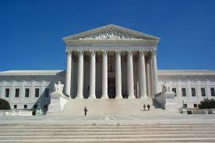
Districting Rules and Goals
Federal Laws
Traditional Redistricting Principles
Equal Population
Federal Voting Rights Act
No Racial Gerrymandering
Communities of interest
Compact
Contiguous
Visible (Natural & man-made) boundaries
Respect voters’ choices / continuity in office
Planned future growth

Slide 7
Demographic Summary
Each of the five divisions must contain about 27,087 people.

Slide 8
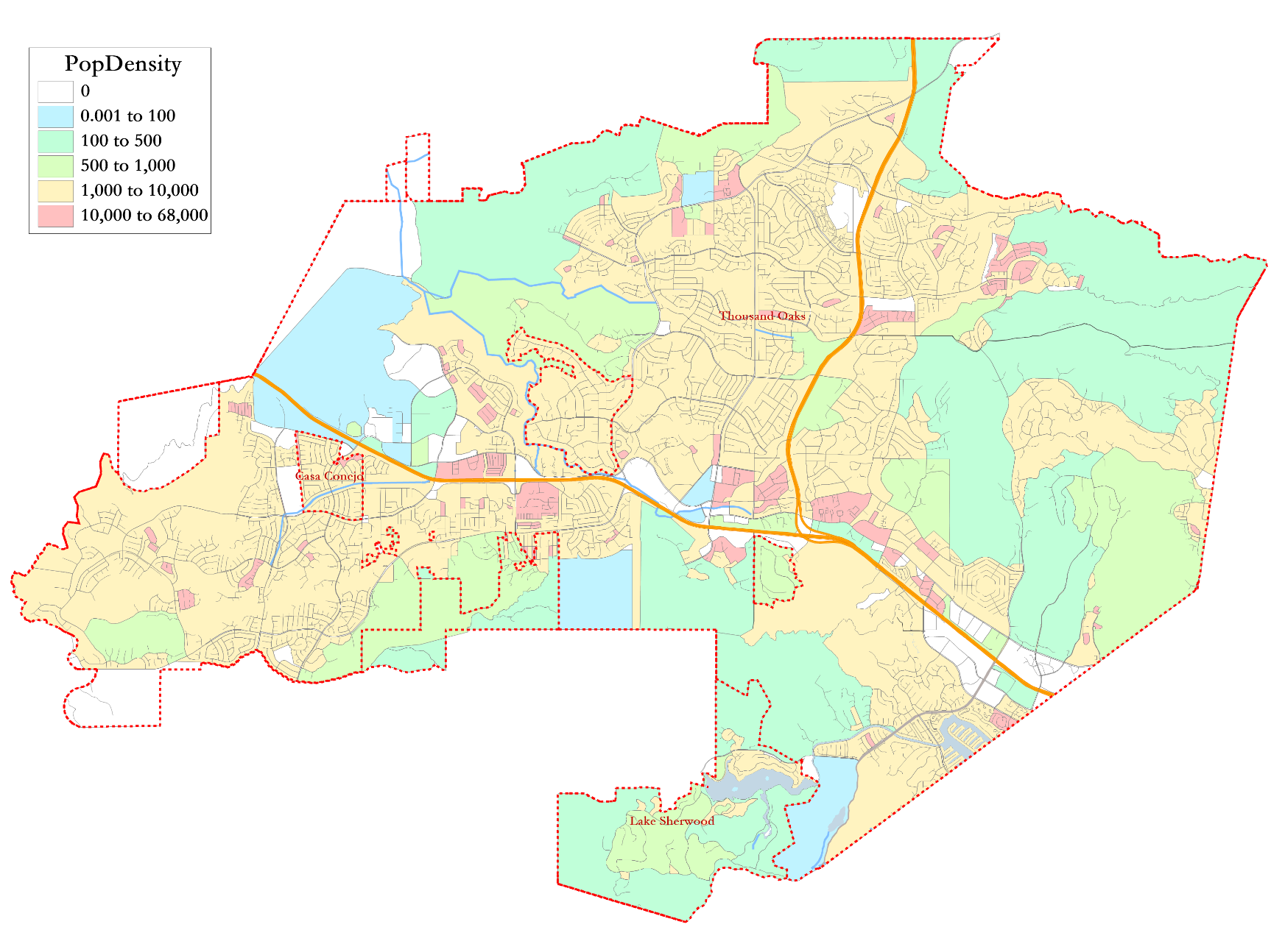
Population Density

Slide 9
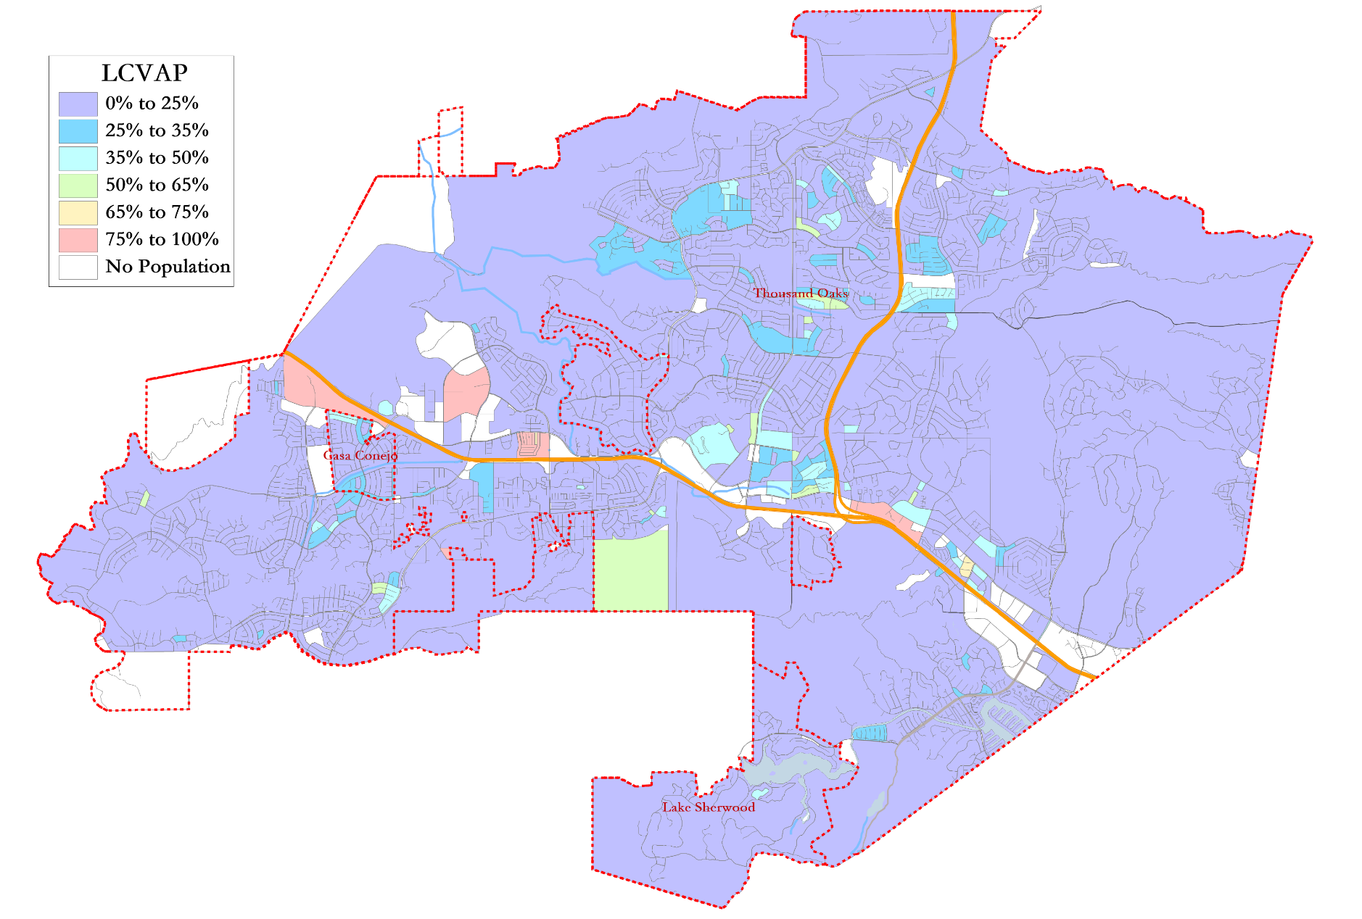
Latino CVAP
Latinos are more concentrated along the 101 freeway.

Slide 10
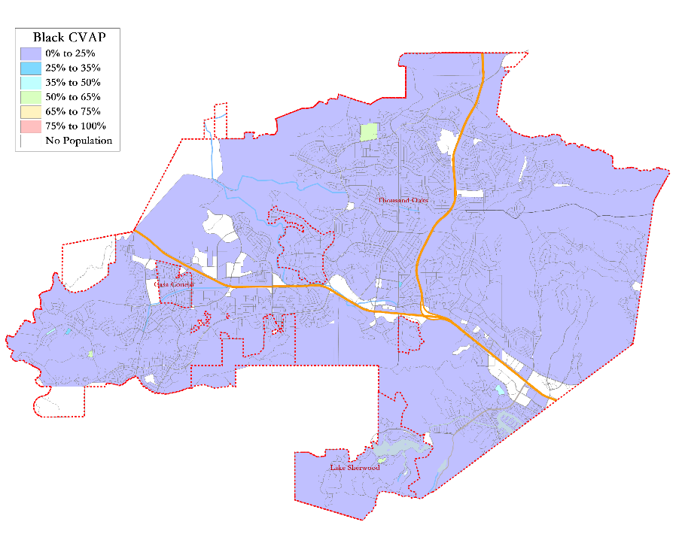
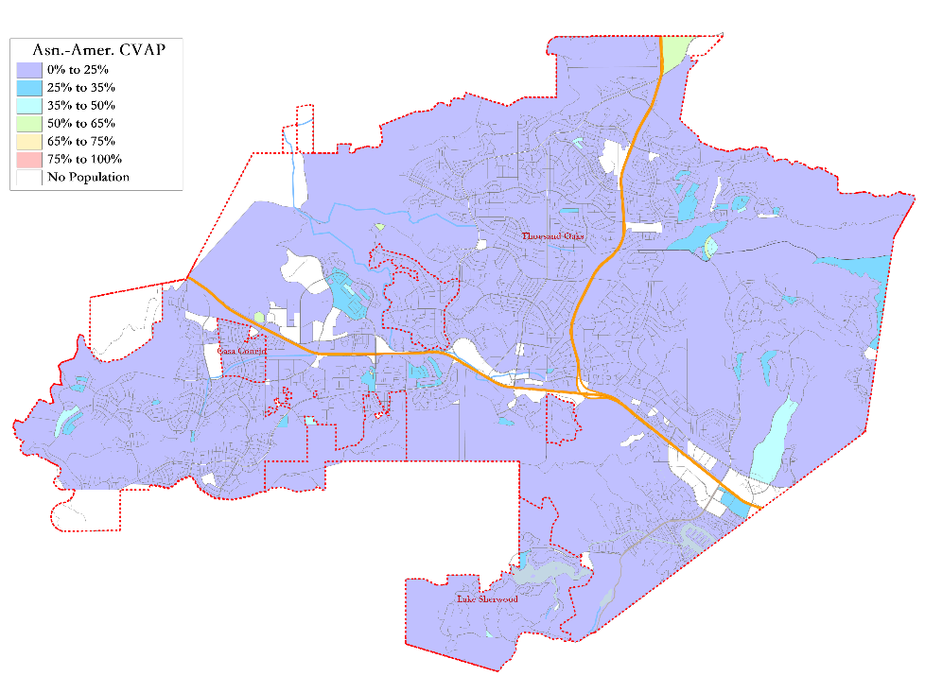
Black and Asian-American CVAP
There are no large geographic concentrations of Black or Asian-American CVAP in the District.

Slide 11
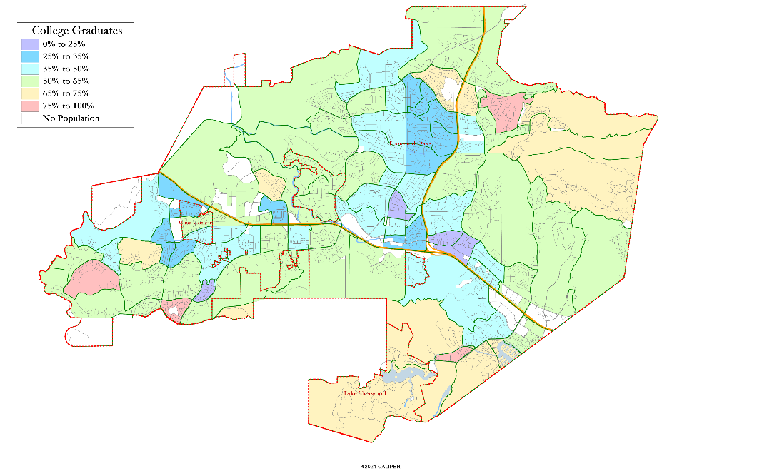
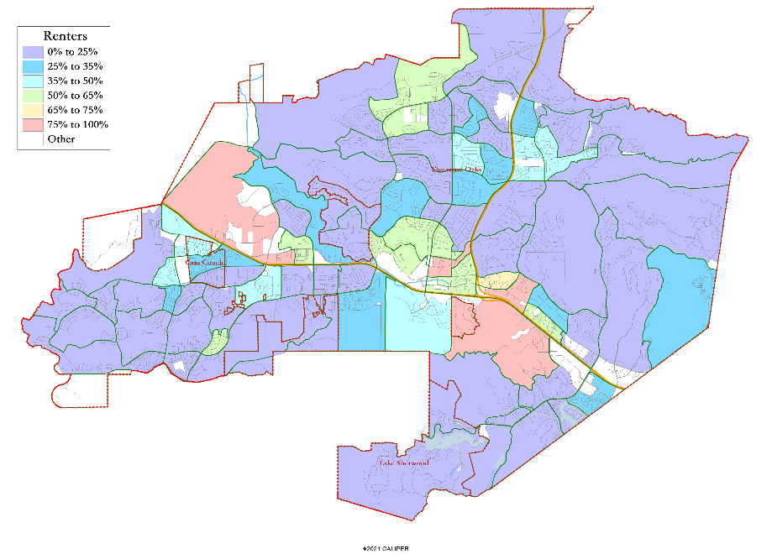
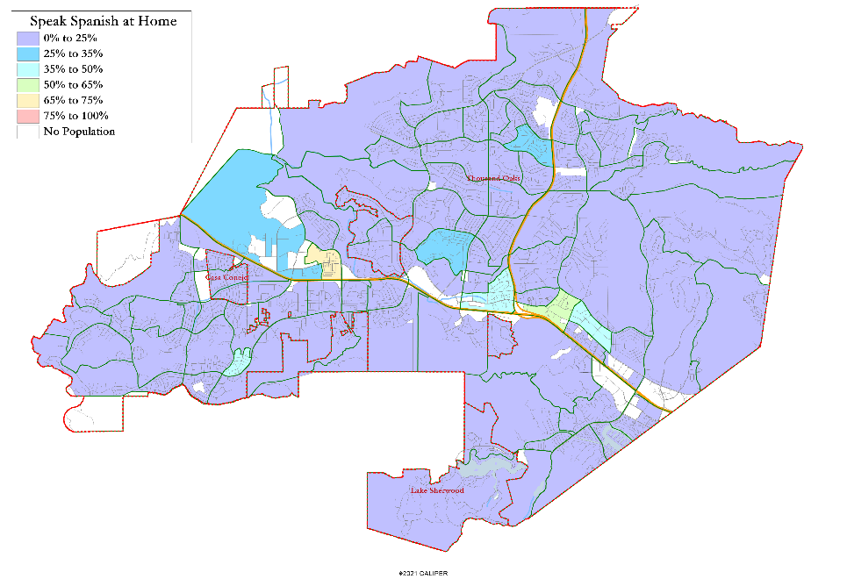
Other Socio-Economic Demographics

Slide 12
Defining Neighborhoods
1st Question: What is your neighborhood?
2nd Question: What are its geographic boundaries?
Examples of physical features defining a neighborhood boundary:
Natural neighborhood dividing lines, such as highway or major roads, rivers, canals and/or hills
Areas around parks or schools
Other neighborhood landmarks
In the absence of public testimony, planning records and other similar documents may provide definition.

Slide 13
Communities of Interest
1st Question: What is your neighborhood or community of interest?
Shared issue or characteristic
Shared social or economic interest
Impacted by county policies
Tell us “your community’s story”
2nd Question: What are its geographic boundaries?
Examples of physical features defining a neighborhood boundary:
Natural neighborhood dividing lines, such as highway or major roads, rivers, canals and/or hills
Areas around parks or schools
Other neighborhood landmarks
In the absence of public testimony, planning records and other similar documents may provide definition.

Slide 14
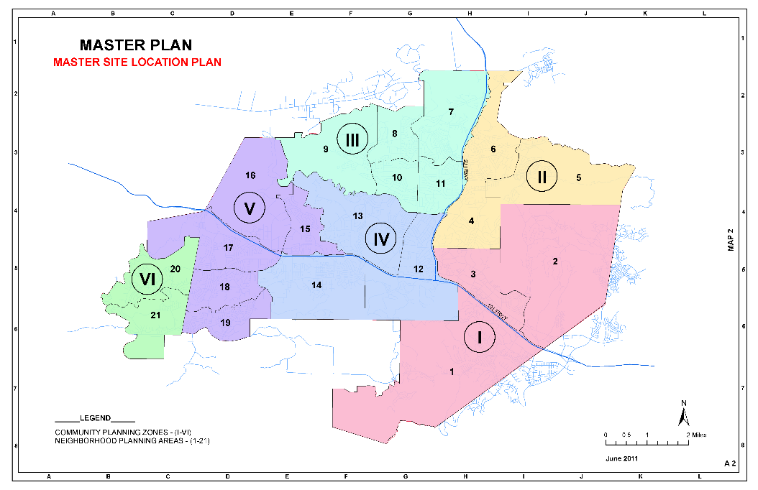
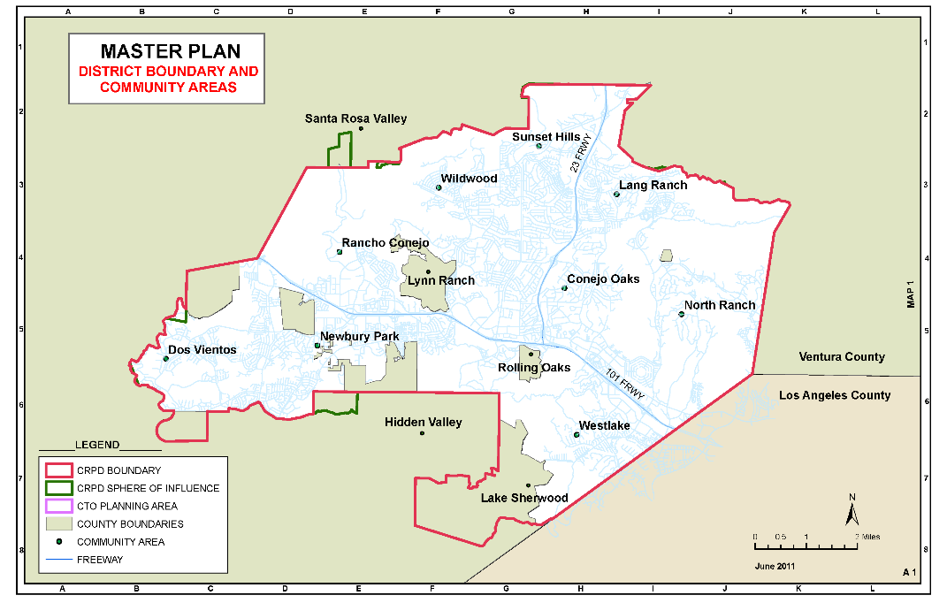
Possible Community Definitions

Slide 15
Public Hearing & Discussion
What is your community of interest and what are its boundaries?
Would you prefer your community of interest be in one trustee area or that it have multiple representatives on the Board?

